Slide 1


Text Classification
Yuanyue Liu – 300150659
Faculté de génie | Faculty of Engineering
uOttawa.ca

Slide 2
Outline
2
Introduction
Purpose
Sample
Data preprocessing
01
02
Feature engineering
Modelling
03
04
Conclusion
Performance

Slide 3
Introduction
Purpose
Compare the results generated from different models
Decide which one is the champion model
Leverage the accuracy of the test
Sample
Exclude books in which there are fewer than 200*100 words.
Randomly selected 5 books written by different authors
Randomly selected 200 chunks from each book and labeled them (make sure each chunk has 100 words)

Slide 4
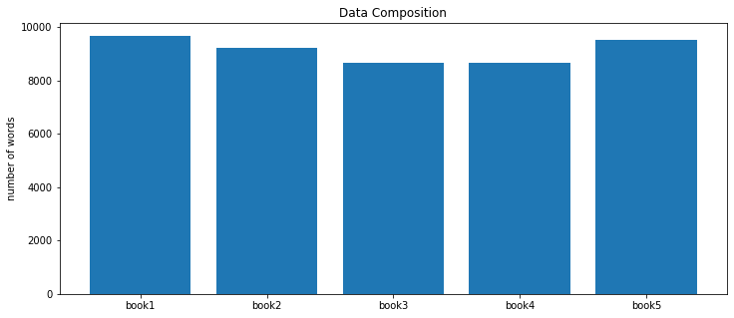
Introduction
Data preprocessing
Convert all letters into lower case
Remove punctuations
Tokenize the documents to remove stopwords (nltk library)
Lemmatization
Split the data into training and validation data using 10-fold cross-validation

Slide 5
Modeling
Feature engineering:
Bag-of-Word(BOW)
TF-IDF
Doc2Vec
Model:
Support Vector Machines (SVM)
K-Nearest Neighbors (KNN)
Decision Tree
Random Forest
Logistic Regression

Slide 6
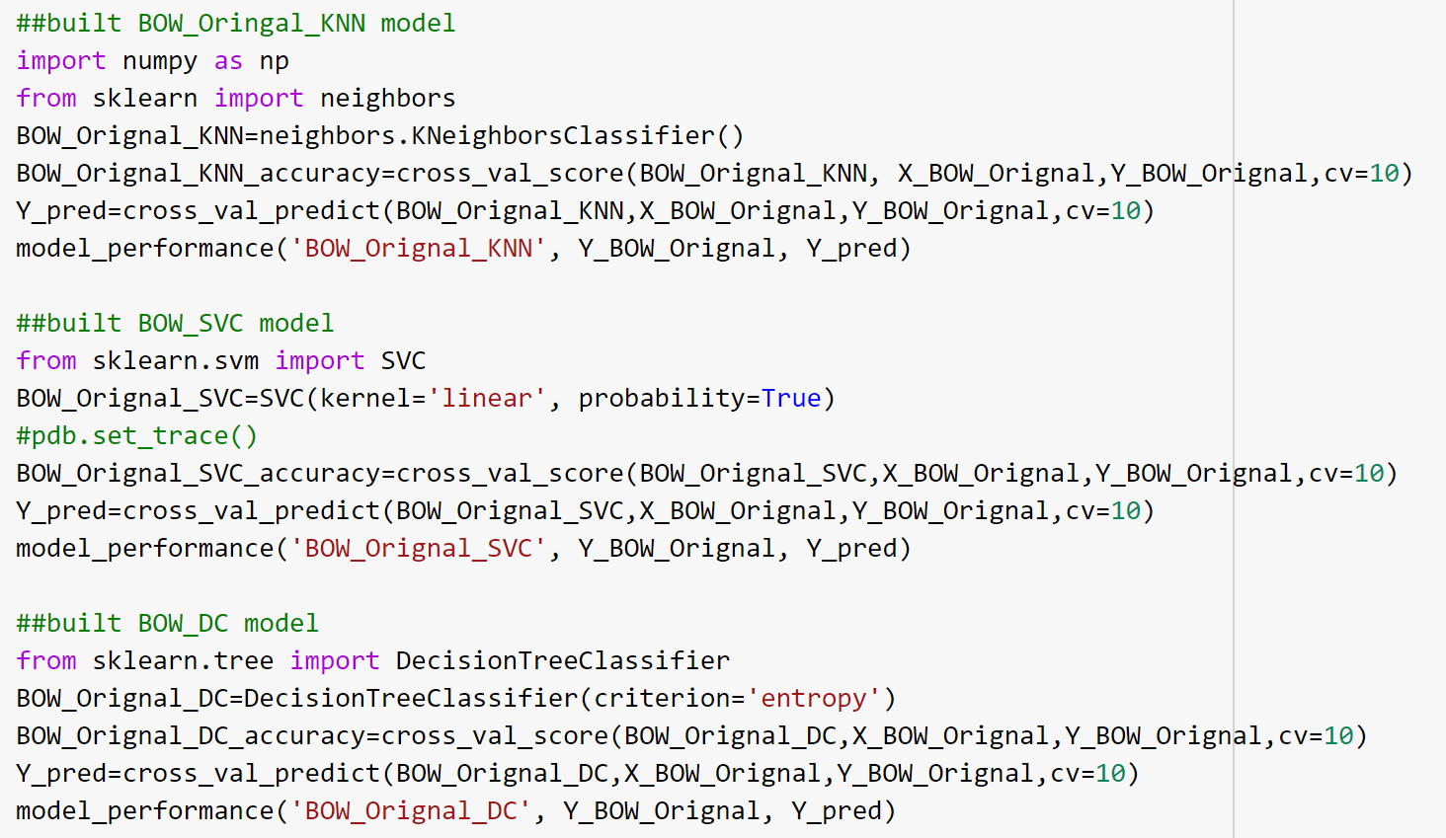
BOW and TF-IDF
from sklearn import neighbors
from sklearn.svm import SVC
from sklearn.tree import DecisionTreeClassifier
from sklearn.model_selection import cross_val_score
from sklearn.model_selection import cross_val_predict
from sklearn.feature_extraction.text import CountVectorizer
from sklearn.feature_extraction.text import TfidfTransformer

Slide 7
Play around
Text clean | Key words left
only keep the entities | 430 key words
Drop stop words and keep entities | 7701 key words
Keep all | 10512 key words
total running time(2 featuring methods*3models*3situations) is about 1hr

Slide 8
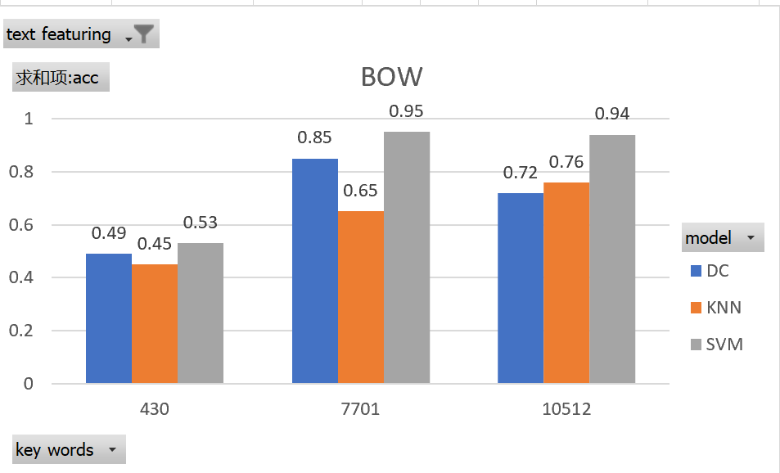
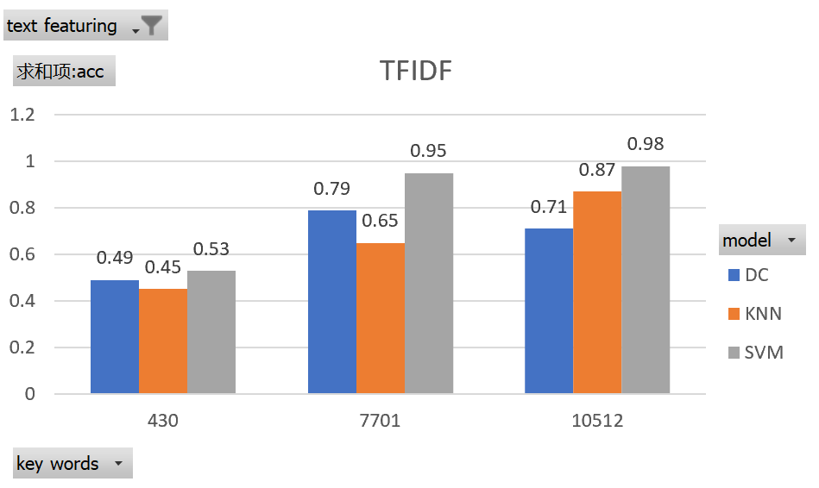
Performance

Slide 9
Performance
9
Modelling | Accuracy | Precision | Recall | F-score
BOW-KNN | 0.65 | 0.65 | 0.65 | 0.65
BOW_SVM | 0.95 | 0.96 | 0.96 | 0.96
BOW_DT | 0.8 | 0.79 | 0.79 | 0.79
TFIDF_KNN | 0.65 | 0.65 | 0.65 | 0.65
TFIDF_SVM | 0.95 | 0.96 | 0.96 | 0.96
TFIDF_DT | 0.79 | 0.79 | 0.79 | 0.79

Slide 10
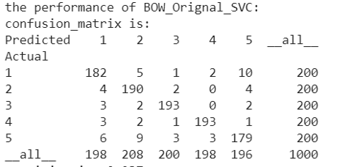
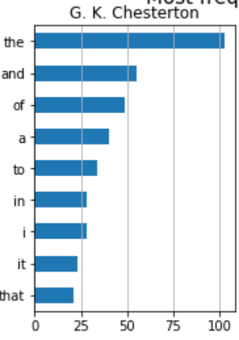
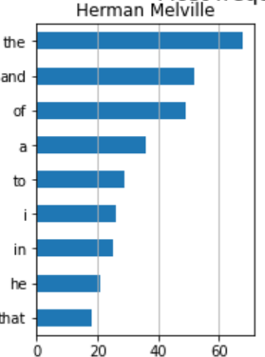
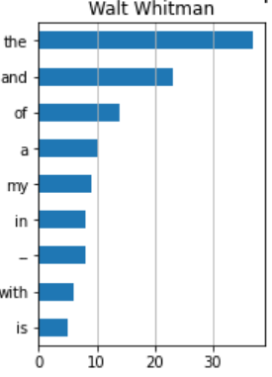
Error analysis
10
Use the original data
1 5 2

Slide 11
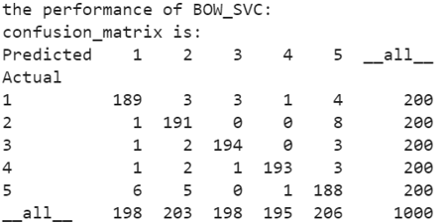
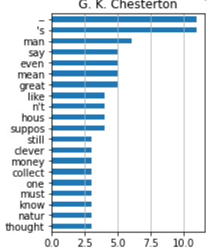
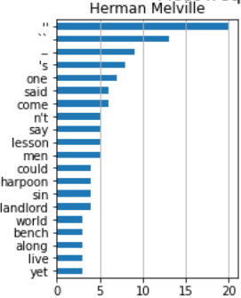
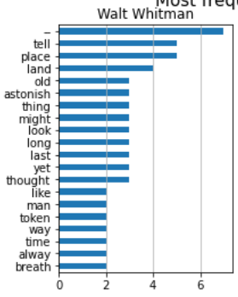
Error analysis
11
1 5 2

Slide 12
Thank you!
12

